Slide 1
FaRM: Fast Remote Memory
Microsoft Research

Slide 2
Features
跑得快（高性能 低延迟）
Strict serializability
RAMCloud + RDMA + K/V store

Slide 3
Content
RDMA ops
Transactions
Hashtable

Slide 4
Trends
Main memory is cheap (as well as SSDs)
100 GB –1 TB per server
10 –100 TBs in a small cluster
New data centre networks
100 Gbps throughput
1-3 μs latency
RDMA primitives
Notes:
趋势
•Keep data in memory
•Access data using RDMA
•Collocate data and computation

Slide 5
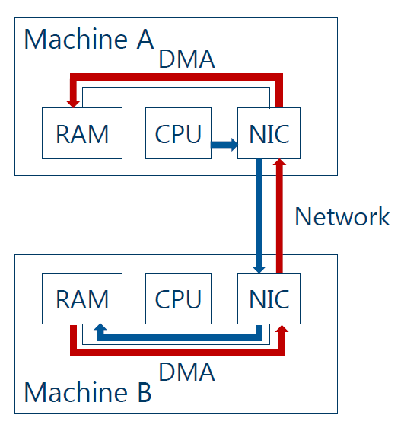
One-sided RDMA read
Infiniband
RoCE (RDMA over Converged Ethernet)

Slide 6
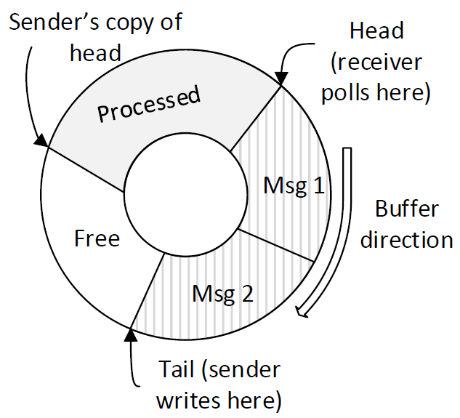
RDMA - message
Communication primitives
Use RDMA write
Copy of head is updated lazily

Slide 7
RDMA Performance Tuning
NIC cache limited – use 2 GB page size to reduce page tables
Too many queue pairs – use shared queues

Slide 8
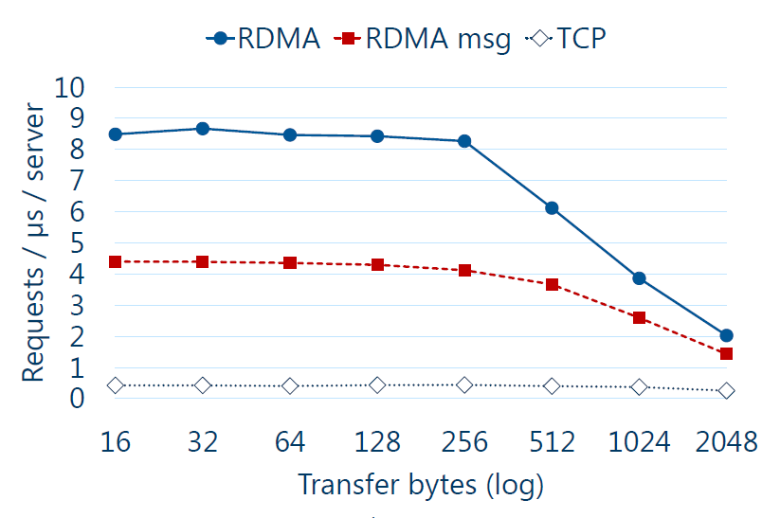
Network Performance

Slide 9
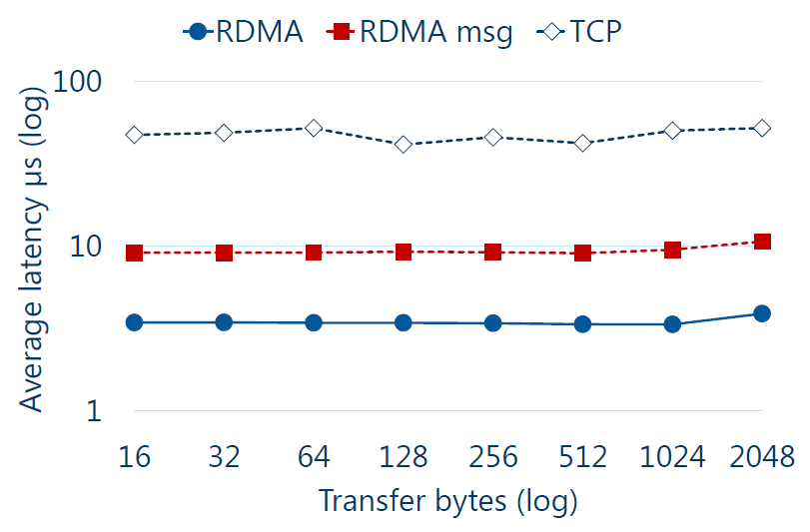
Network Performance

Slide 10
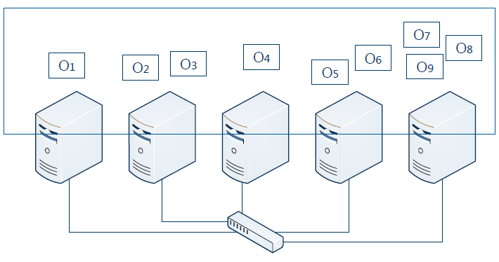
Architecture
Machines store data and execute application

Slide 11
Shared Address Space
2GB region + continues hashing
cluster – region
machine – block
thread – slab (from 64 bytes to 1 MB)
Slab allocation: same block → same region → same virtual ring nearby position

Slide 12
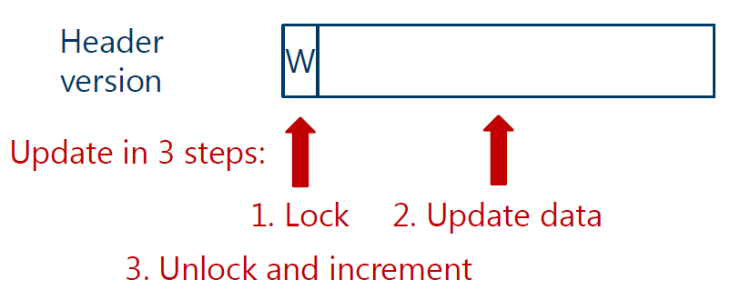
ACID Transactions
Atomicity, Consistency, Isolation & Durability

Slide 13
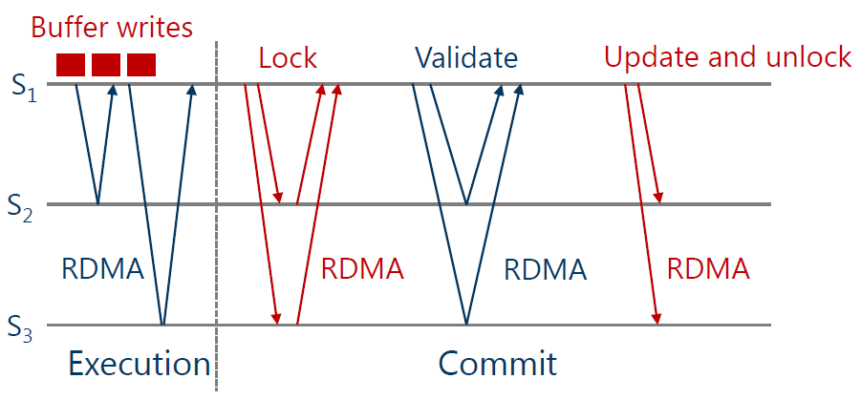
Transactions

Slide 14
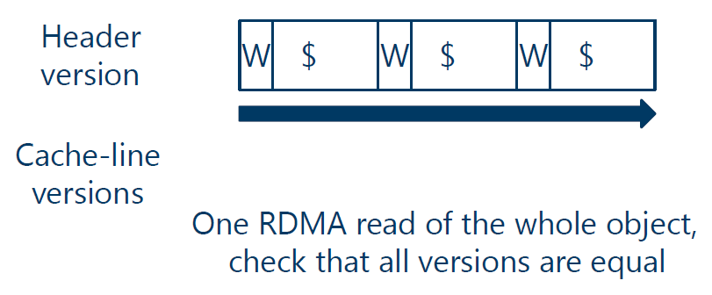
Lock-free Reads
Objects are first locked in a mode that allows lock-free reads

Slide 15
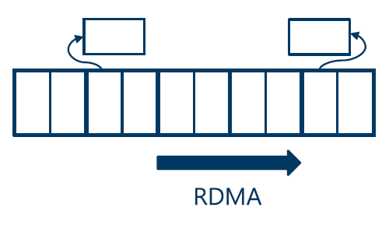
Hashtable
“chained associative hopscotch hashing”
Original: 37% occupancy with H = 8
FaRM: 1.04 RDMA reads per lookup with H = 8 at 90% occupancy

Slide 16
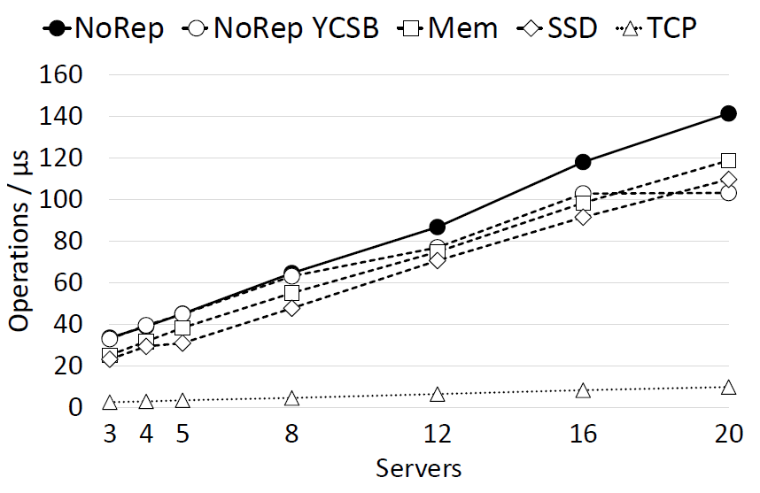
Evaluation

Slide 17
Evaluation
Compared with Facebook’s Tao
6 Mops/s/srv (10x)
42 μs average latency (50x)

Slide 18

Thank you!

